Slide 1
Wednesday, 17 September
Web Designer Course
Learn step-by-step how to become a professional web designer
Presented by:
Morgan Maxwell

Slide 2
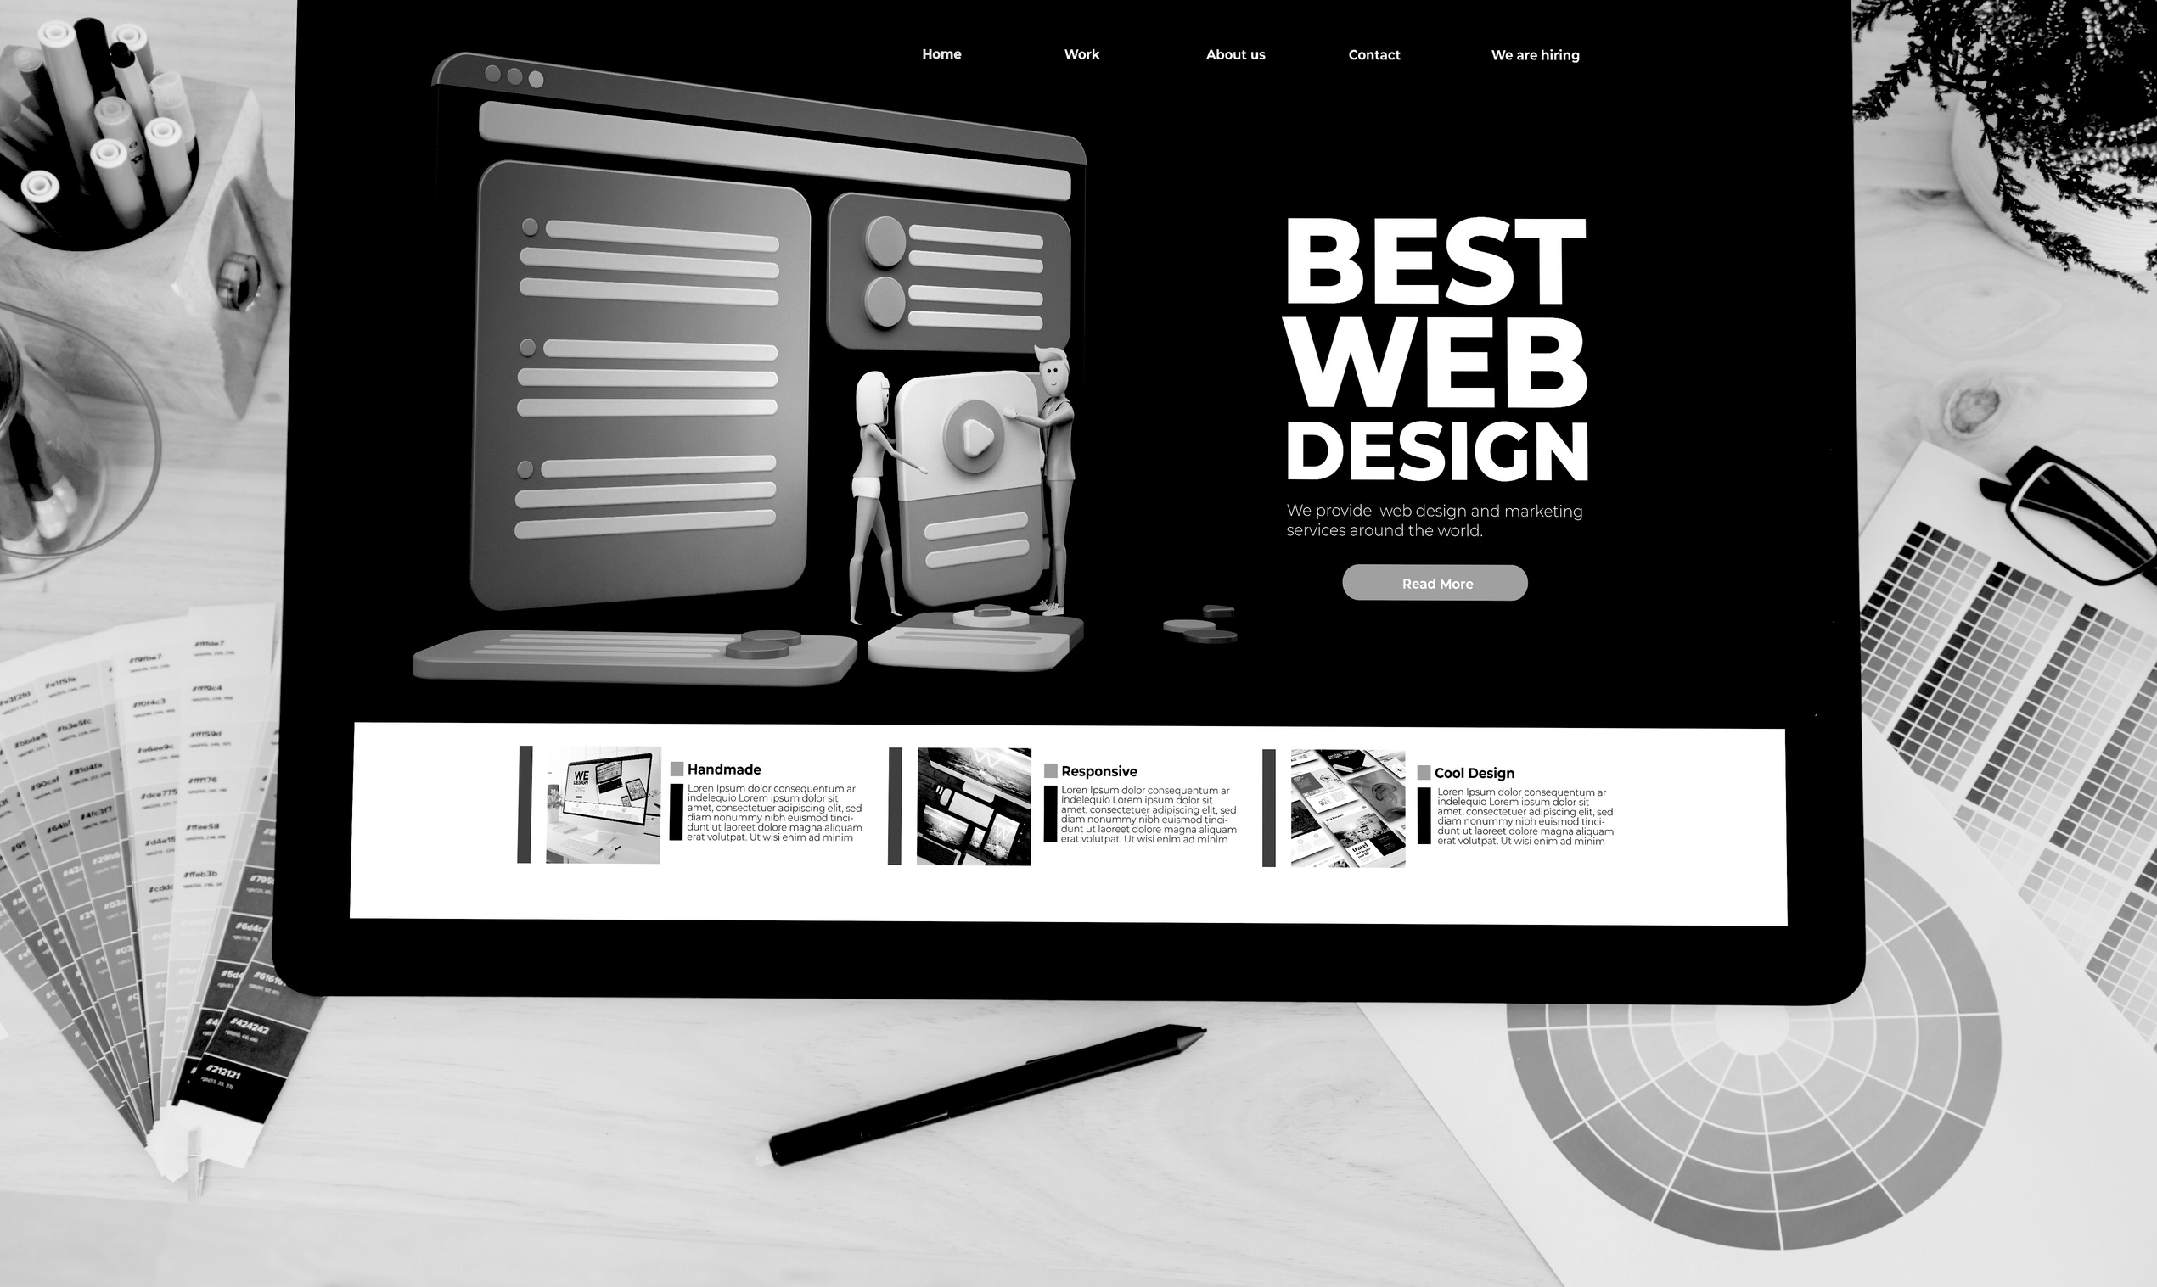
What Is Web Design?
Web design is a design process designed to develop and create the visual appearance and user experience of a website. Web design involves combining visual elements, color, typography, and layout. Web design also focuses on the user experience and user interface.

Slide 3
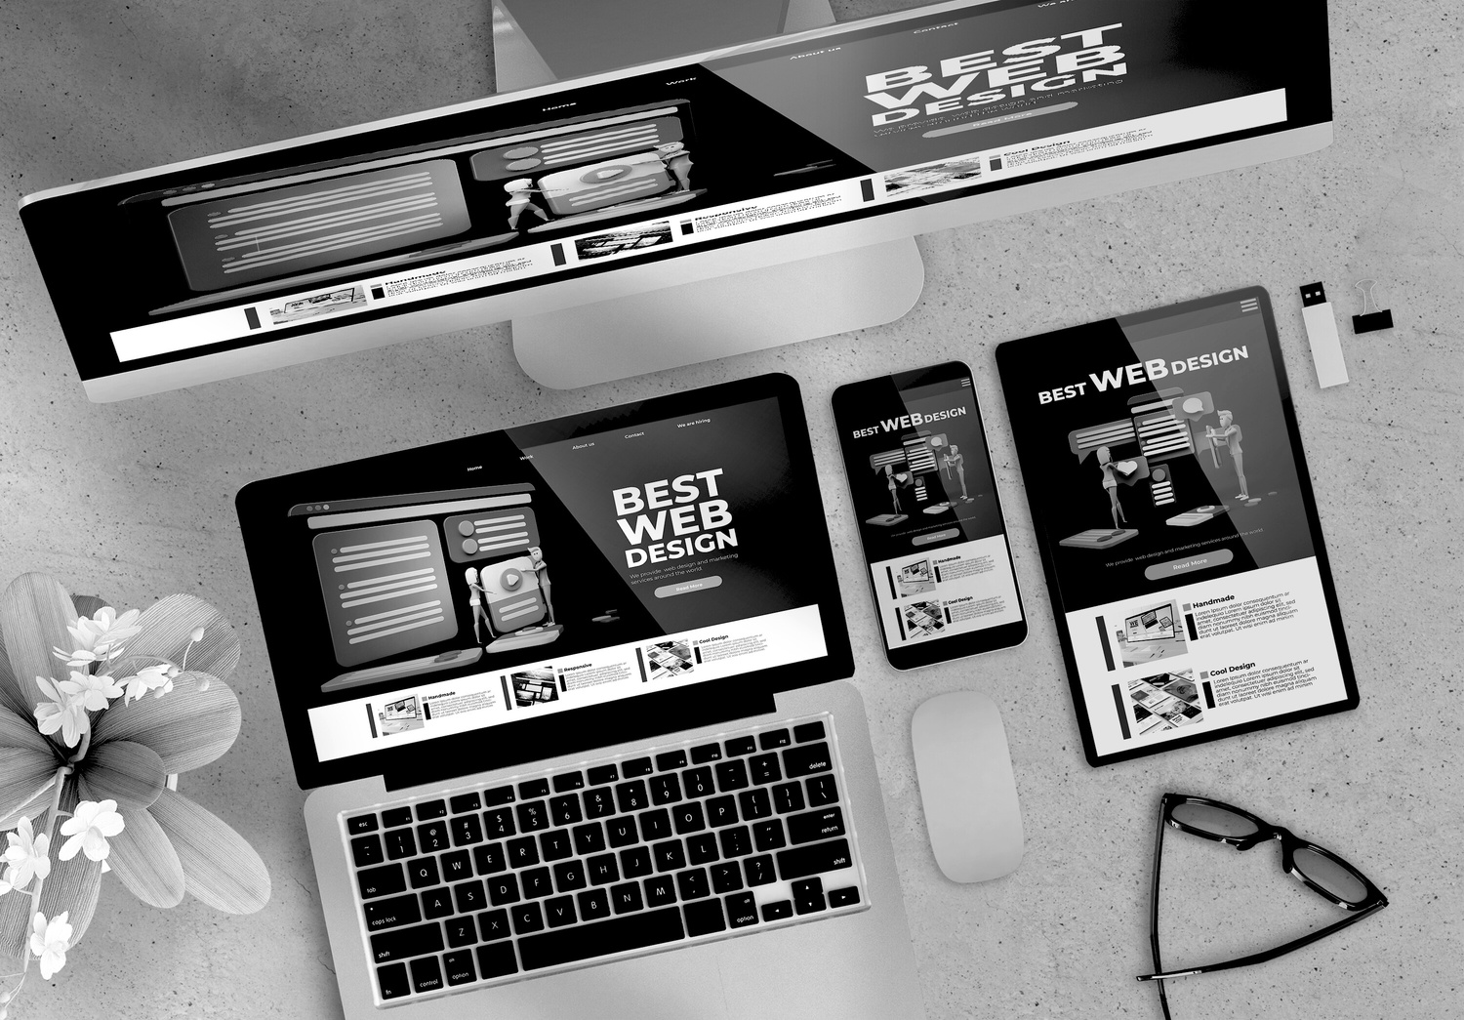
The Purpose of Web Design
The primary goal of web design is to create a visually appealing website that is functional and effective in achieving business goals. The following are the goals of web design:
Effective Communication
Increased Conversions
01
03
Improved User Experience
Supported Branding
02
04

Slide 4


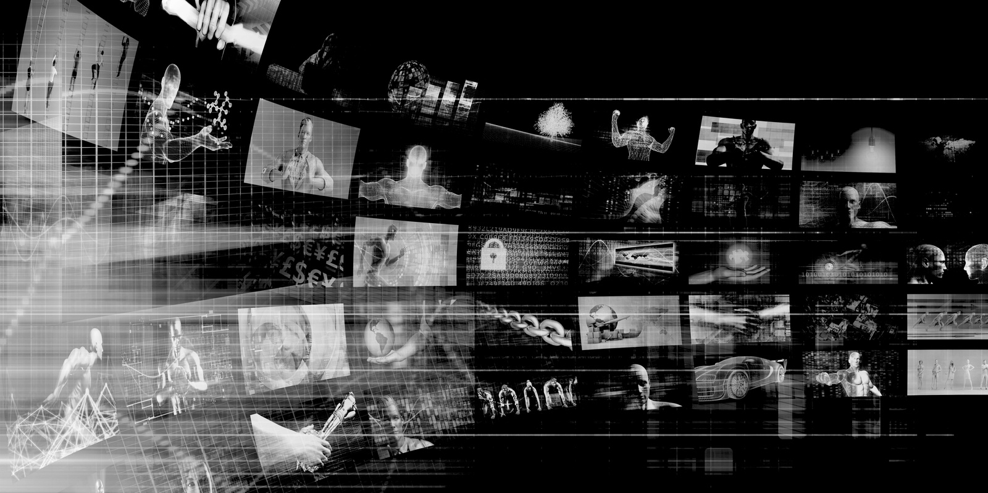
Benefits of Web Design
Good web design not only enhances the aesthetics of a website, but also provides various benefits for businesses and users. Here are some of the benefits of web design:
01
Attracting Visitors
02
Increasing Engagement
Enhancing Business Credibility
03

Slide 5

Required Skills
There are several skills required in web design, including:
01
Graphic design fundamentals
04
Basic HTML & CSS
02
Understanding of typography and color
05
Creativity and problem solving
03
Knowledge of layout and grid systems

Slide 6
Common Tools for Web Design
Visual Design
Code Editor
Used for creating wireframes, mockups, and prototypes
Helps determine layout, colors, and typography
Creating and editing HTML, CSS, and JavaScript
Useful for understanding the basic structure of a website
Browser Developer Tools
Asset Management
Checking how a website looks on various devices
Testing website speed and performance
Organizing images, icons, and design files
Keeping your project organized and accessible

Slide 7
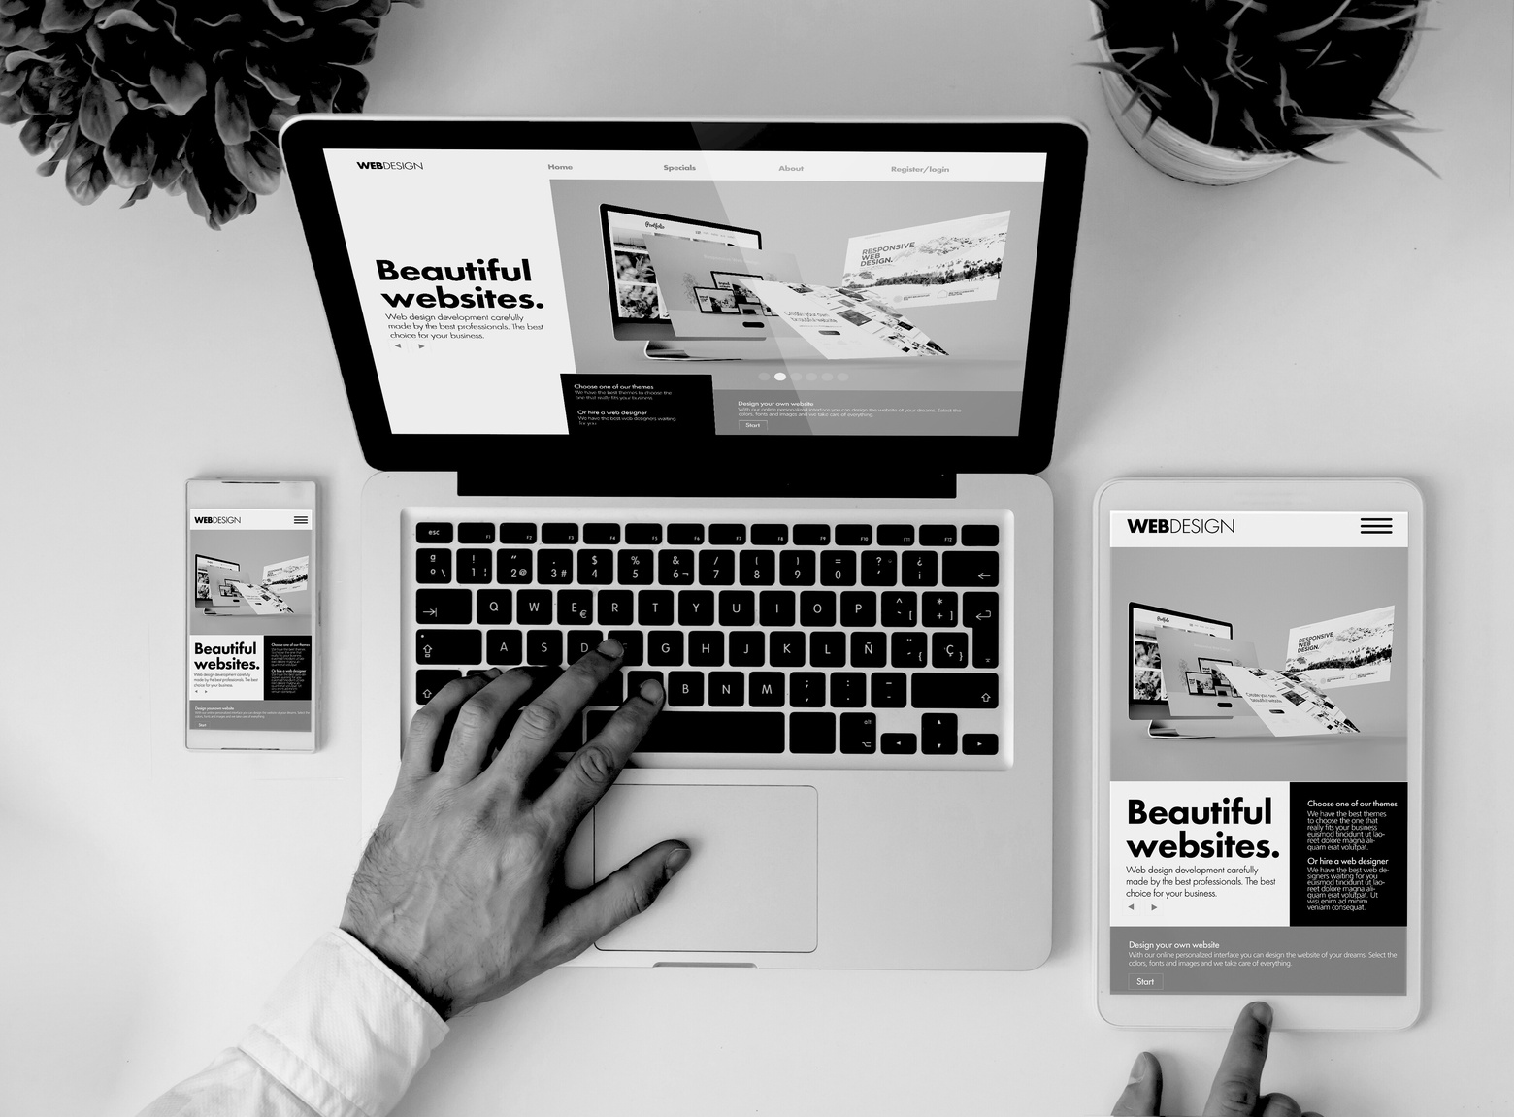
Web Design Principles
In web design, there are several principles to consider, namely:
Consistency: a uniform visual style
Readability: clear and easy-to-read text
Simple navigation: an easy-to-use user interface
Responsiveness: adapts to various devices
Contrast: balanced colors and elements

Slide 8
Basic Website Structure
A website typically has several basic structures, such as the following:
01
Header
02
Hero Section
03
Main Content
04
@powerpointrus
05
Footer

Slide 9

Web Designer Workflow
Research
Wireframe
Design Mockup
Prototype Testing
Implementation and Revisio

Slide 10

Wednesday, 17 September
Thank You

